Slide 1
Instruction Execution and Interconnection Structure
Lecture 02
Instructor: Tapushe Rabaya Toma
Lecturer (Senior Scale), SWE, DIU

Slide 2
Reference Books
Computer Organization and Architecture: Designing for Performance- William Stallings (8th Edition)
Any later edition is fine

Slide 3
Overview
At a top level, a computer consists of CPU (central processing unit), memory, and I/O components, with one or more modules of each type
These components are interconnected in some fashion to achieve the basic function of the computer
At a top level, we can describe a computer system by
Describing the external behavior of each component—that is, the data and control signals that it exchanges with other components; and
Describing the interconnection structure and the controls required to manage the use of the interconnection structure

Slide 4
Overview
Virtually all contemporary computer designs are based on concepts developed by John von Neumann at the Institute for Advanced Studies, Princeton
Such a design is referred to as the von Neumann architecture and is based on three key concepts:
Data and instructions are stored in a single read–write memory
The contents of this memory are addressable by location, without regard to the type of data contained there
Execution occurs in a sequential fashion (unless explicitly modified) from one instruction to the next

Slide 5
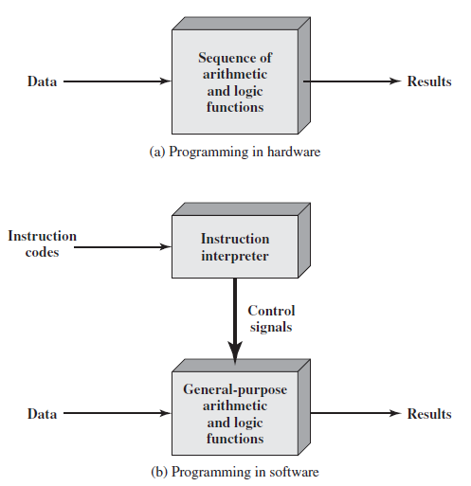
Types of Programming
Two types:
Hardwired Programming
Software Programming

Slide 6
GP Processor
Figure b indicates two major components of the system: an instruction interpreter and a module of general-purpose arithmetic and logic functions
These two constitute the CPU
Several other components are needed to yield a functioning computer
Data and instructions must be put into the system and results must be shown in realizable forms
We need I/O module for that
A place is also needed for storing the data and instructions
We need Memory for that

Slide 7
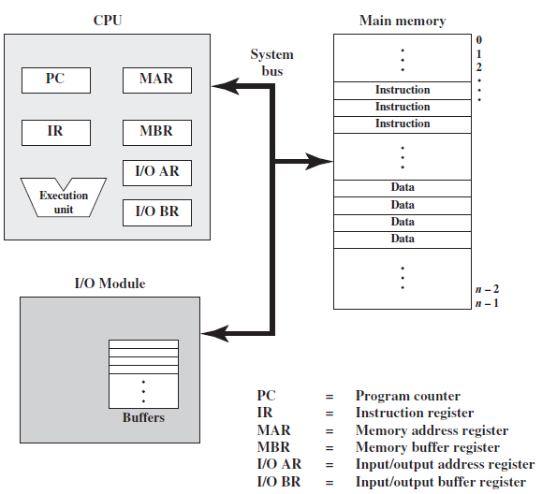
GP Processor

Slide 8
GP Processor
Figure illustrates these top-level components
CPU exchanges data with memory
For this purpose, it typically makes use of two internal (to the CPU) registers: a memory address register (MAR), which specifies the address in memory for the next read or write, and a memory buffer register (MBR), which contains the data to be written into memory or receives the data read from memory
Similarly, an I/O address register (I/OAR) specifies a particular I/O device
An I/O buffer (I/OBR) register is used for the exchange of data between an I/O module and the CPU

Slide 9
Function of GPP
The basic function performed by a computer is execution of a program, which consists of a set of instructions stored in memory
In its simplest form, instruction processing consists of two steps:
The processor reads (fetches) instructions from memory one at a time and executes each instruction
Program execution consists of repeating the process of instruction fetch and instruction execution
The processing required for a single instruction is called an instruction cycle

Slide 10
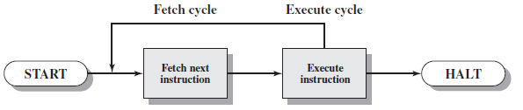
Instruction Fetch and Execute
In a typical processor, a register called the program counter (PC) holds the address of the instruction to be fetched next
Unless told otherwise, the processor always increments the PC after each instruction fetch so that it will fetch the next instruction in sequence

Slide 11
Instruction Fetch and Execute
The fetched instruction is loaded into a register in the processor known as the instruction register (IR)
The instruction contains bits that specify the action the processor is to take
In general, these actions fall into four categories:
Processor-memory: Data may be transferred from processor to memory or from memory to processor
Processor-I/O: Data may be transferred to or from a peripheral device by transferring between the processor and an I/O module
Data processing: The processor may perform some arithmetic or logic operation on data
Control: An instruction may specify that the sequence of execution be altered

Slide 12
Instruction Fetch and Execute
For example, the processor may fetch an instruction from location 149, which specifies that the next instruction be from location 182. The processor will remember this fact by setting the program counter to 182
Thus, on the next fetch cycle, the instruction will be fetched from location 182 rather than 150

Slide 13
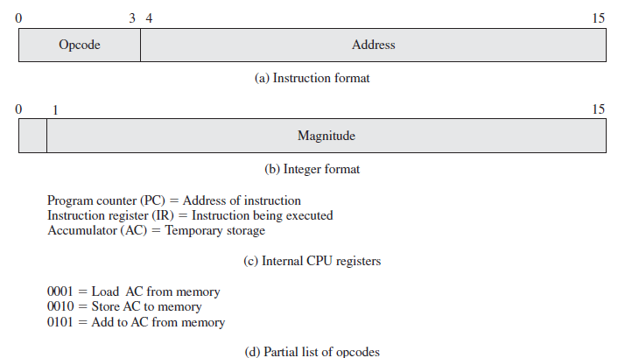
A Hypothetical Processor

Slide 14
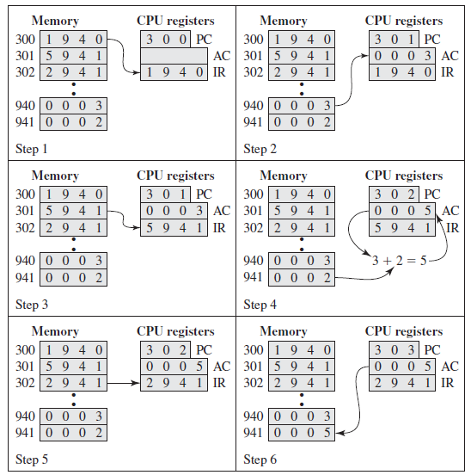
A Hypothetical Processor

Slide 15
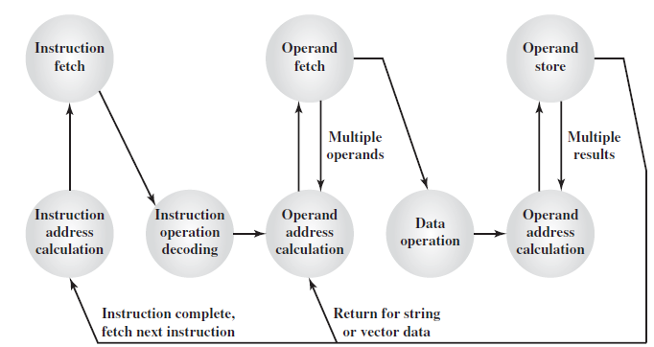
Instruction Cycle State Diagram

Slide 16
Instruction Cycle States
Instruction address calculation (iac)
Instruction fetch (if)
Instruction operation decoding (iod)
Operand address calculation (oac)
Operand fetch (of)
Data operation (do)
Operand store (os)

Slide 17
Interrupts
Virtually all computers provide a mechanism by which other modules (I/O, memory) may interrupt the normal processing of the processor
Interrupts are provided primarily as a way to improve processing efficiency
For details, refer to textbook

Slide 18
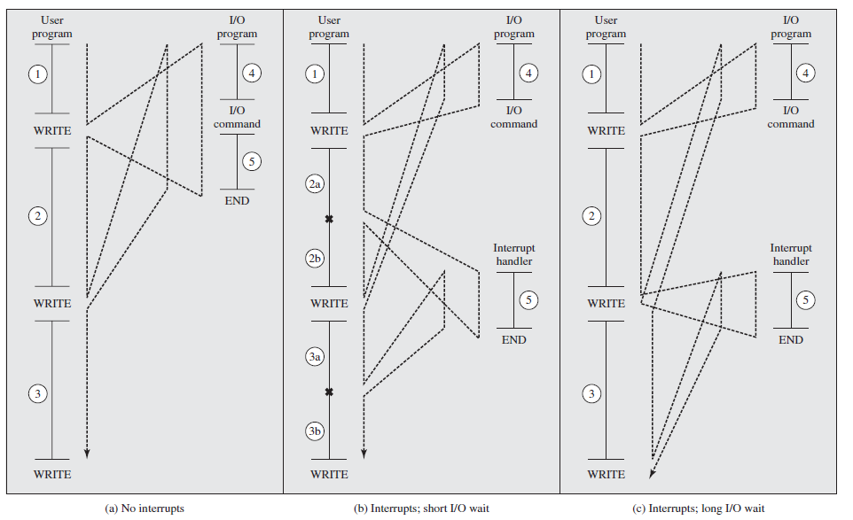
Program Flow of Control with and w/o Interrupt

Slide 19
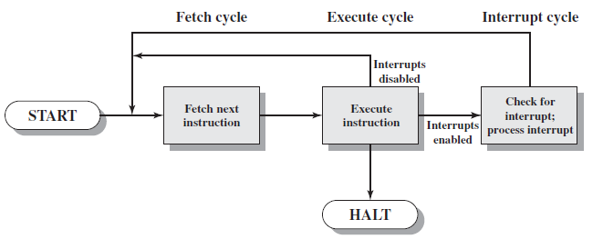
Instruction Cycle with Interrupt

Slide 20
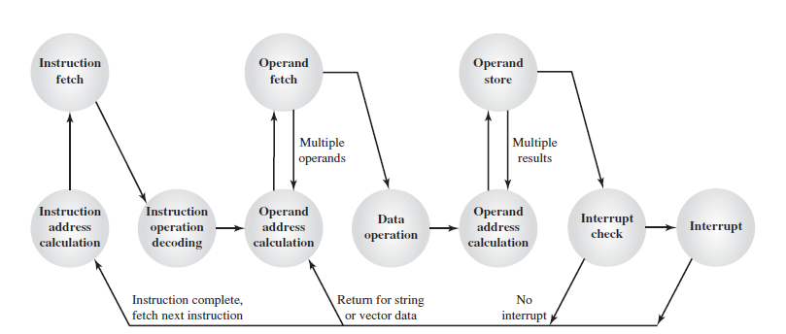
Instruction Cycle with Interrupt

Slide 21
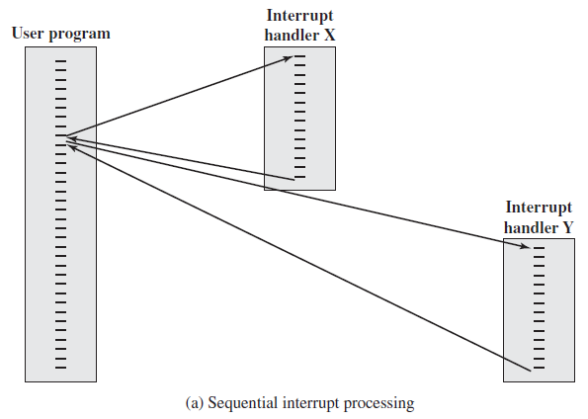
Interrupt Handling

Slide 22
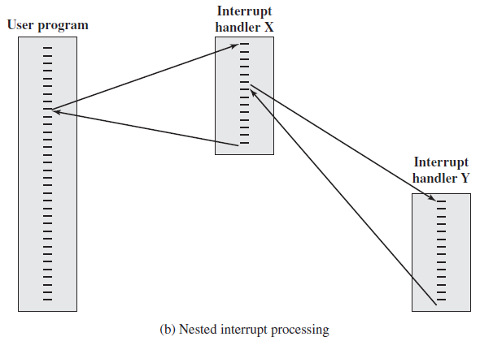
Interrupt Handling

Slide 23
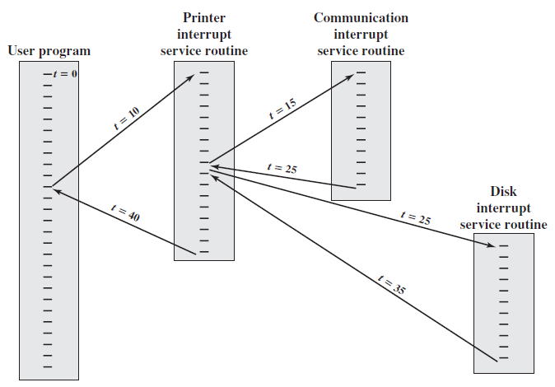
Multiple Interrupt Handling

Slide 24
Assignment 1
Write a short article on Interrupt mechanism found in Processors
Make sure that your article covers the following topics:
Concept of Interrupt
Instruction Cycle State Diagram with interrupt
Transfer of control with interrupt
Applications
Submission due: February, 2021

Slide 25
Interconnection Structure
The collection of paths connecting the various modules is called the interconnection structure
The interconnection structure must support the following types of transfers:
Memory to processor: The processor reads an instruction or a unit of data from memory
Processor to memory: The processor writes a unit of data to memory
I/O to processor:The processor reads data from an I/O device via an I/O module
Processor to I/O: The processor sends data to the I/O device
I/O to or from memory: For these two cases, an I/O module is allowed to exchange data directly with memory, without going through the processor, using direct memory access (DMA)

Slide 26
BUS Interconnection
A bus is a communication pathway connecting two or more devices
It is a shared transmission medium
Consists of multiple communication pathways, or lines, each line is capable of transmitting signals representing binary 1 and binary 0
Multiple devices connect to the bus, and a signal transmitted by any one device is available for reception by all other devices attached to the bus
If two devices transmit during the same time period, their signals will overlap and become garbled
Only one device at a time can successfully transmit
A bus that connects major computer components (processor, memory, I/O) is called a system bus

Slide 27
Bus Structure
A system bus consists, typically, of from about 50 to hundreds of separate lines
Each line is assigned a particular meaning or function
Any bus the lines can be classified into three functional groups: data, address, and control lines
There may be power distribution lines that supply power to the attached modules

Slide 28
DATA BUS
The data lines provide a path for moving data among system modules
These lines, collectively, are called the data bus
The data bus may consist of 32, 64, 128, or even more separate lines, the number of lines being referred to as the width of the data bus
Because each line can carry only 1 bit at a time, the number of lines determines how many bits can be transferred at a time
Width: If the data bus is 32 bits wide and each instruction is 64 bits long, then the processor must access the memory module twice during each instruction cycle

Slide 29
ADDRESS BUS
The address lines are used to designate the source or destination of the data on the data bus
For example, if the processor wishes to read a word (8, 16, or 32 bits) of data from memory, it puts the address of the desired word on the address lines
The width of the address bus determines the maximum possible memory capacity of the system.
Typically, the higher-order bits are used to select a particular module on the bus, and the lower-order bits select a memory location or I/O port within the module
For example, on an 8-bit address bus, address 01111111 and below might reference locations in a memory module (module 0) with 128 words of memory, and address 10000000 and above refer to devices attached to an I/O module (module 1)

Slide 30
CONTROL BUS
The control lines are used to control the access to and the use of the data and address lines
Control signals transmit both command and timing information among system modules
Timing signals indicate the validity of data and address information
Command signals specify operations to be performed
Typical control lines include:
Memory write, Memory read, I/O write, I/O read, Transfer ACK, Bus request, Bus grant, Interrupt request, Interrupt ACK, Clock, Reset, Hold, Hold ACK

Slide 31
Multiple-Bus Hierarchies
Motivated by two major concerns:
In general, the more devices attached to the bus, the greater the bus length and hence the greater the propagation delay
The bus may become a bottleneck as the aggregate data transfer demand approaches the capacity of the bus
Most computer systems use multiple buses, generally laid out in a hierarchy

Slide 32
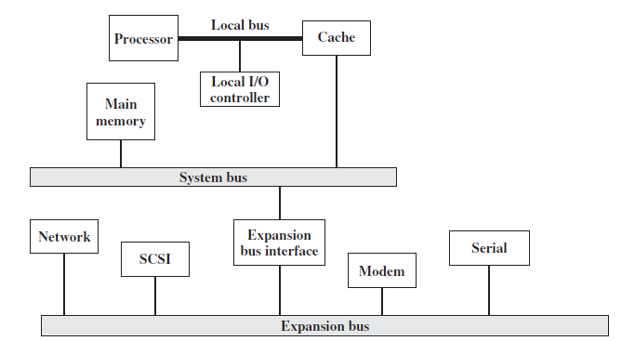
Traditional BUS Architecture

Slide 33
Traditional BUS Architecture
Network connections include local area networks (LANs) such as a 10-Mbps Ethernet and connections to wide area networks (WANs) such as a packet-switching network
SCSI (small computer system interface) is itself a type of bus used to support local disk drives and other peripherals
A serial port could be used to support a printer or scanner

Slide 34
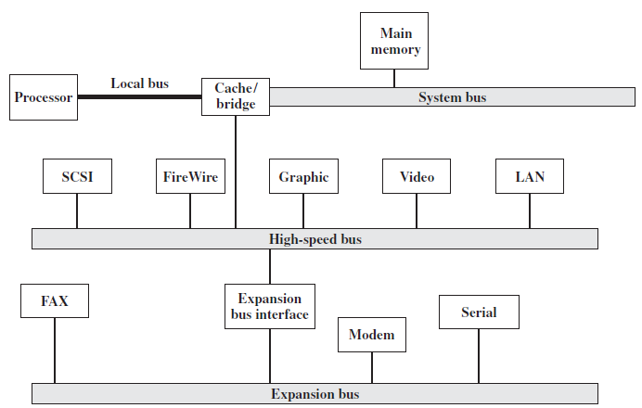
High-Performance Architecture

Slide 35
High-Performance Architecture
There is a local bus that connects the processor to a cache controller, which is in turn connected to a system bus that supports main memory
The cache controller is integrated into a bridge, or buffering device, that connects to the high-speed bus
This bus supports connections to high-speed LANs, such as Fast Ethernet at 100 Mbps, video and graphics workstation controllers, as well as interface controllers to local peripheral buses, including SCSI and FireWire
The latter is a high-speed bus arrangement specifically designed to support high-capacity I/O devices
Lower-speed devices are still supported off an expansion bus, with an interface buffering traffic between the expansion bus and the high-speed bus

Slide 36
High-Performance Architecture
The advantage of this arrangement is that the high-speed bus brings high demand devices into closer integration with the processor and at the same time is independent of the processor
Thus, differences in processor and high-speed bus speeds and signal line definitions are tolerated
Changes in processor architecture do not affect the high-speed bus, and vice versa

Slide 37
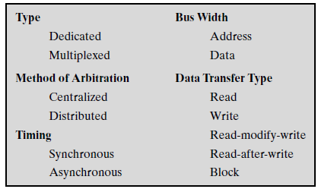
Elements of Bus Design

Slide 38
Method of Arbitration
Roughly Two categories: Centralized and Distributed
In a centralized scheme, a single hardware device, referred to as a bus controller or arbiter, is responsible for allocating time on the bus
The device may be a separate module or part of the processor
In a distributed scheme, there is no central controller
Rather, each module contains access control logic and the modules act together to share the bus
With both methods of arbitration, the purpose is to designate one device, either the processor or an I/O module, as master

Slide 39
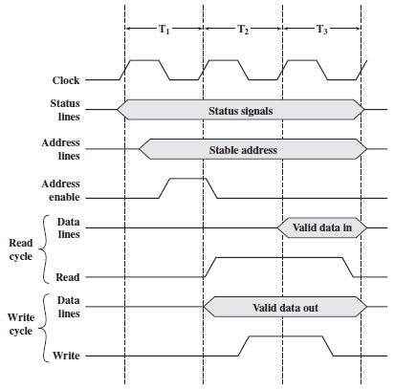
Timing
With synchronous timing, the occurrence of events on the bus is determined by a clock
The bus includes a clock line upon which a clock transmits a regular sequence of alternating 1s and 0s of equal duration

Slide 40
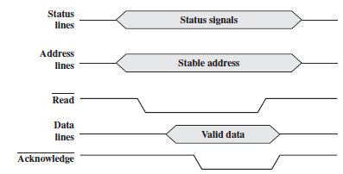
Timing
With asynchronous timing, the occurrence of one event on a bus follows and depends on the occurrence of a previous event

Slide 41
Thanks!

